Slide 1

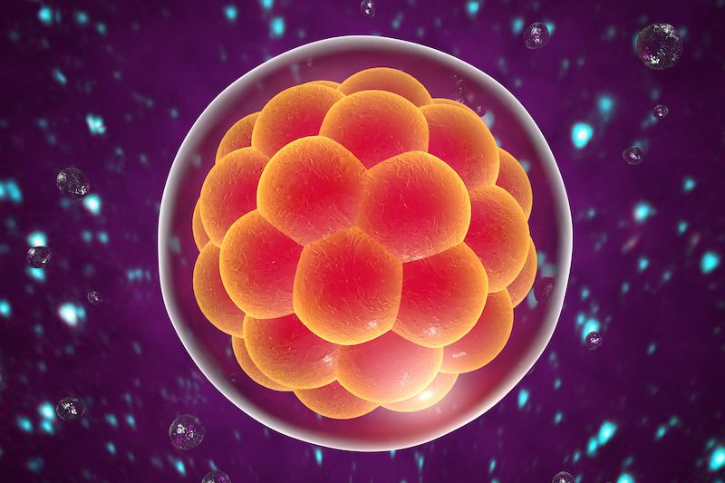
EMBRYO QUALITY PREDICTION
Presented By :
ANTHATI PALLAVI GOWD

Slide 2


Embryo Quality Prediction System
01
02
03
04
05
Project Overview
Business Problem
Business Objective
CRISP-ML(Q) Methodology
Technical Stacks
Outline the project goals and framework.
Identify key challenges in embryo quality assessment.
Define objectives and constraints for the project.
Detail the technologies and tools used in the project.
Utilize CRISP-ML(Q) for structured model development.
06
07
08
09
10
Data Collection
Data Preprocessing
Model Building
Deployment Strategy
Future Scopes
Gather and validate relevant data for analysis.
Prepare data for modeling through cleansing and visualization.
Construct predictive models and evaluate accuracy.
Plan for deploying the predictive model effectively.
Explore potential future enhancements and research areas.

Slide 3








Embryo Quality Prediction System
01
Image Analysis Pipeline
06
Batch Processing
Processes embryo microscopy images through standardized workflows for consistency and accuracy.
Recently added feature allowing batch validation for processing multiple images simultaneously.
02
Multi-Architecture Support
07
Database Integration
Utilizes various CNN architectures like ResNet152, EfficientNet, ConvNeXt, and SwinV2 for optimal performance.
Stores patient predictions for clinical reference, facilitating better decision-making in IVF procedures.
03
Interactive Dashboard
08
Full ML Lifecycle
Offers a web-based visualization of model performance metrics, enhancing user engagement and analysis.
Covers the entire machine learning lifecycle from data preparation to deployment and monitoring.
04
Quality Assessment
Enables real-time embryo grading with confidence scoring to assist clinicians in decision-making processes.
05
Explainable AI
Incorporates Grad-CAM visualizations to make model decisions interpretable for end-users.

Slide 4





Challenges in Embryo Selection
01
02
03
Low Success Rates
Subjective Assessment
Resource Intensive
IVF procedures have approximately 30-35% success rates globally.
Traditional embryo grading relies on visual inspection, leading to high inter-observer variability.
Manual assessment requires significant time and expertise from specialized embryologists.
04
05
Standardization Issues
Decision Support Gaps
Inconsistent grading criteria exist across different clinics and practitioners.
Limited technological assistance hampers embryologists in making critical selection decisions.

Slide 5
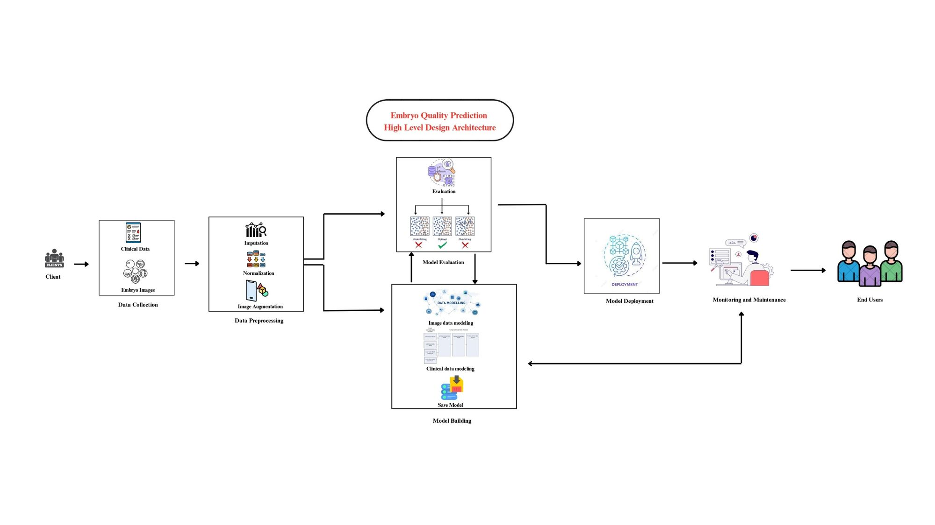

High-Level Design (HLD) Architecture

Slide 6
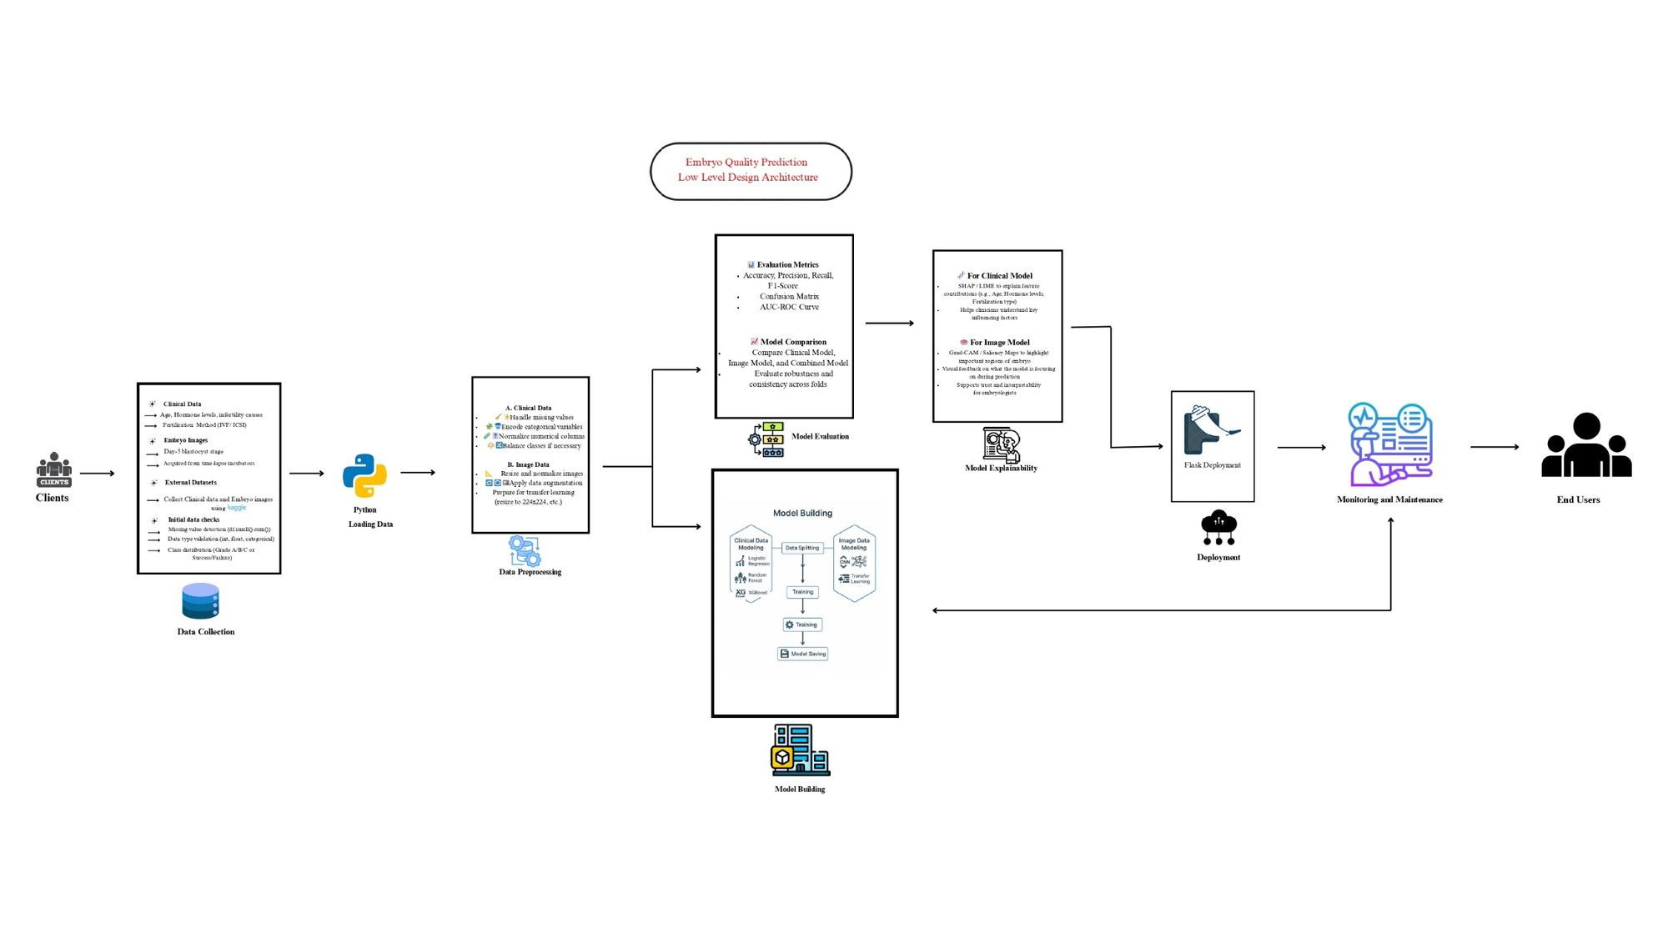

Low-Level Design (LLD) Architecture

Slide 7


Business Objectives and Constraints
● Business Constraint - Minimize the treatment cost
● Success Criteria:
o Business Success Criteria - Increase the success rate of ART procedures by at least 10%
o Machine Learning Success Criteria – achieve at least by 95%
o Economic Success Criteria - Achieve a cost saving of at least 25% by reducing the expenditure on working with embryos of lower grading.

Slide 8
There are six stages of CRISP-ML(Q) Methodology
1.Business and data understanding
2.Data preparation
3.model building
4.Model evaluation
5.Model deployment
6.Monitoring and maintenance

Slide 9








Comprehensive Technical Stacks
01
Core Data Science: Python, NumPy
02
Deep Learning Frameworks: PyTorch
03
Image Processing Tools: OpenCV
04
Web Application Development: Flask
Utilizing Python as the primary programming language along with NumPy and Pandas for data manipulation and numerical computing tasks essential for embryo quality prediction.
Employing PyTorch as the core deep learning framework, and utilizing TorchVision for computer vision tasks to enhance embryo quality evaluation.
Integrating OpenCV for image preprocessing and manipulation along with Pillow for loading and transforming images relevant to embryo assessment.
Using Flask as the web framework to create dashboards and APIs, with Jinja2 for HTML templating and Werkzeug for WSGI support.
05
Data Visualization: Matplotlib/Seaborn
06
Database Management: MySQL
07
Authentication Mechanisms: Flask-Login
08
Explainable AI Techniques: Grad-CAM
Implementing Matplotlib and Seaborn for static visualizations, and Plotly for interactive dashboards to visualize embryo quality data effectively.
Leveraging MySQL for database management which facilitates storage for patient predictions and user management related to embryo quality.
Incorporating Flask-Login for user session management and bcrypt for secure password hashing to ensure data protection.
Utilizing Grad-CAM for gradient-weighted class activation mapping to provide insights into model predictions on embryo quality.

Slide 10

Embryo Quality Prediction Tools
Our core service is developing technology that connects drivers and riders on demand. Here’s how the app works, step by step:

Slide 11


Core Data Science: Python & Libraries
Utilizes Python as the primary language alongside NumPy and Pandas for effective data manipulation and numerical computations.

Slide 12

Deep Learning Framework: PyTorch
Employs PyTorch for deep learning tasks, supplemented by TorchVision for image processing and pre-trained models.

Slide 13
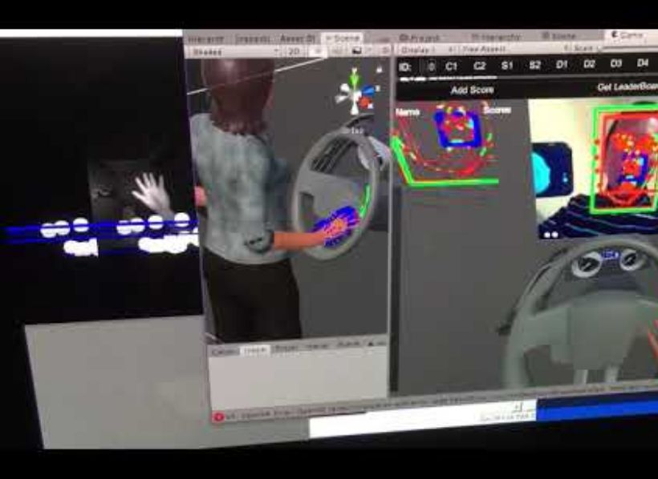
Image Processing Tools: OpenCV & Pillow
Incorporates OpenCV for image preprocessing and Pillow for image loading and transformations to enhance data quality.

Slide 14

Web Application: Flask Framework
Develops the web application using Flask for dashboards and APIs, Jinja2 for templating, and Werkzeug for utility functions.

Slide 15

Data Visualization: Matplotlib & Plotly
Leverages Matplotlib and Seaborn for static visualizations and Plotly for creating interactive dashboards for data insights.

Slide 16

Database Management: MySQL Integration
Utilizes MySQL for storing patient predictions and manages connections via MySQL Connector for seamless operations.

Slide 17

Authentication: Secure User Sessions
Implements Flask-Login for managing user sessions and bcrypt for secure password hashing to protect user data.

Slide 18

Explainable AI: Grad-CAM Techniques
Adopts Grad-CAM for generating heatmaps, facilitating understanding of model decisions in the prediction process.

Slide 19
















Embryo Image Dataset Overview
Total Images
Image Types
Image Dimensions
Class Distribution
Data Source
Format
Resolution
Clinical Partner Contributions, Public Research Datasets, Simulated/Augmented Data
Light microscopy images from different developmental stages
Typically 72-300 DPI depending on source equipment
Initially imbalanced, with more blastocyst images than early-stage embryos
1500 embryo microscopy images
Various original sizes, standardized to 224x224 pixels
Primarily JPEG and PNG formats

Slide 20










Data Dictionary
Overview of Data Attributes
Column Name
Data Type
Description
Constraints
id
INT
Unique identifier for each prediction
Primary Key, Auto-increment
image_path
VARCHAR(255)
Path to the original embryo image file
NOT NULL
patient_name
VARCHAR(100)
Name of the patient (optional)
NULL allowed
predicted_class_index
INT
Numeric index of the predicted embryo quality
NOT NULL
predicted_class
VARCHAR(100)
Name of the predicted embryo quality class
NOT NULL
confidence
FLOAT
Confidence score of the prediction
NOT NULL, Range: 0–1
timestamp
DATETIME
When the prediction was made
NOT NULL
created_at
DATETIME
Record creation timestamp
DEFAULT CURRENT_TIMESTAMP

Slide 21








System Requirements
Overview of Required Components
Component
Requirement
Description
Operating System
Windows 10/11, macOS, Linux
Supported platforms for development and deployment
Python
Version 3.8 or higher
Required for running scripts and backend code
MySQL
MySQL Server 8.0 or higher
For database operations and storage
CUDA Toolkit
Optional (GPU only)
Required for GPU-based model training or inference
Browser
Chrome, Firefox, etc.
Modern browser needed to access the web application

Slide 22
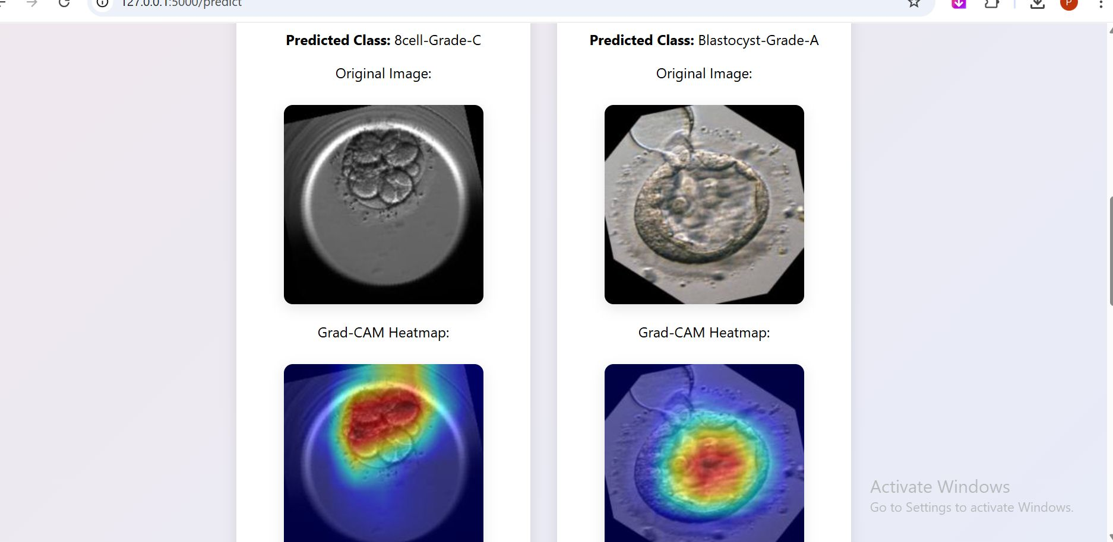
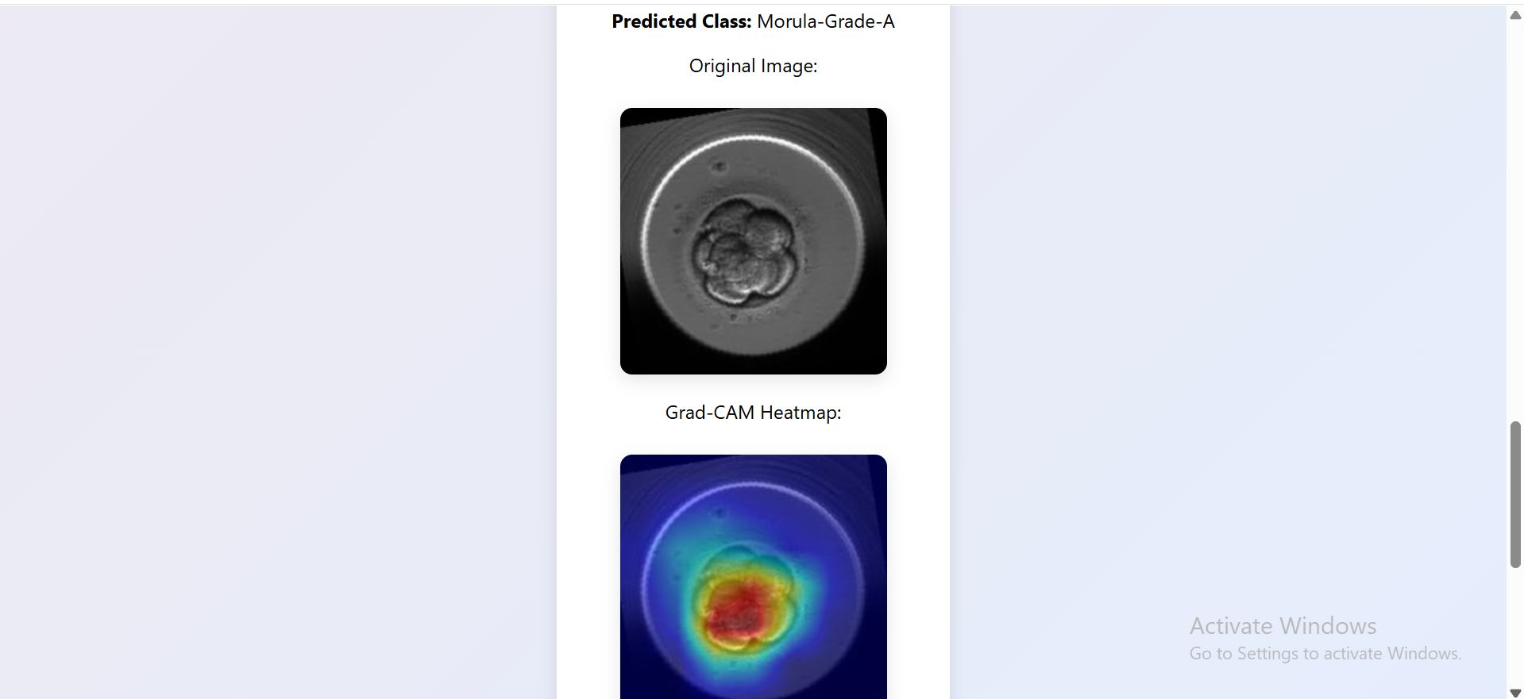
Data Visualization

Slide 23
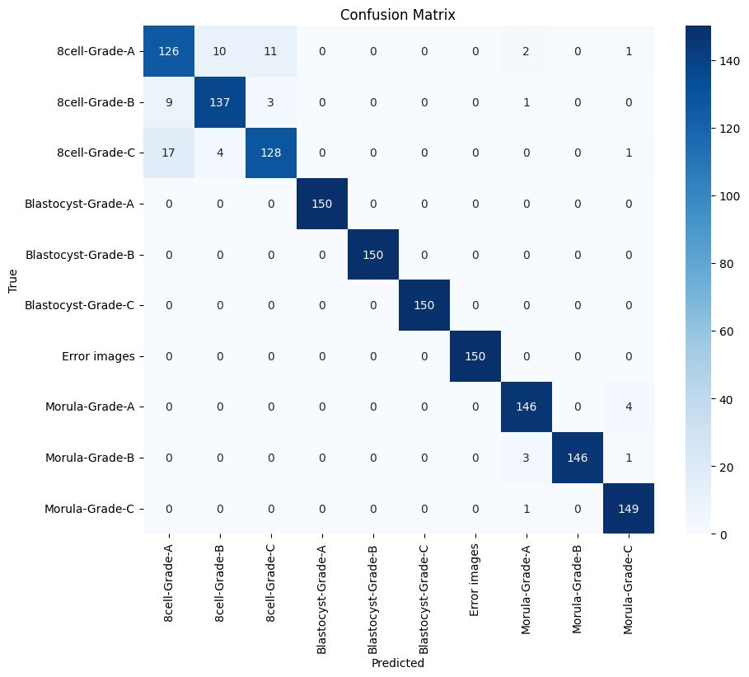
Model Evaluation

Slide 24
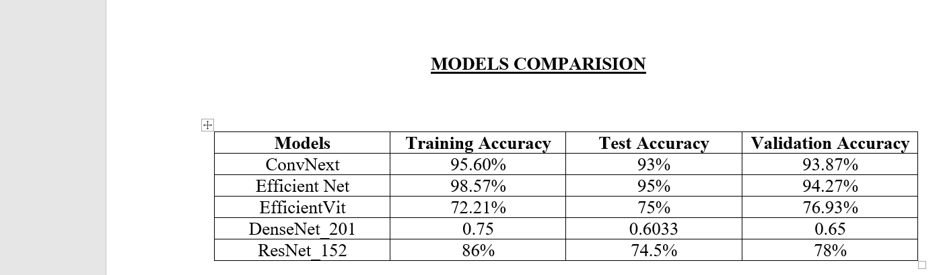
Best Model – Efficient Net

Slide 25
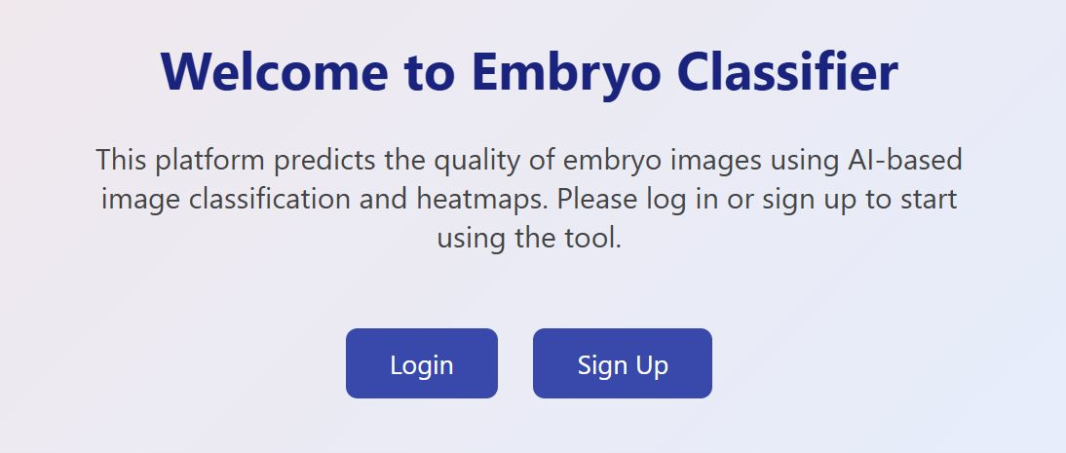
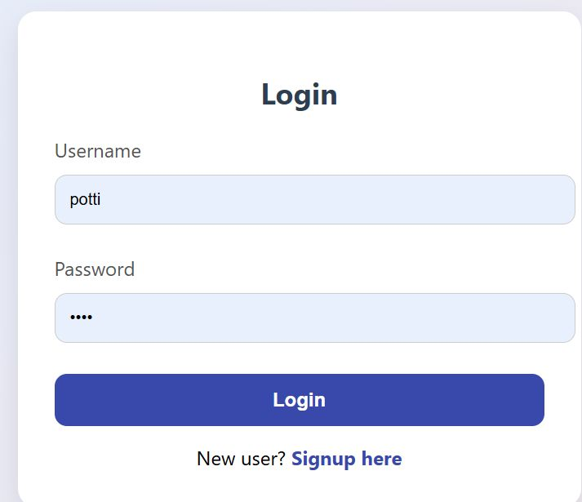
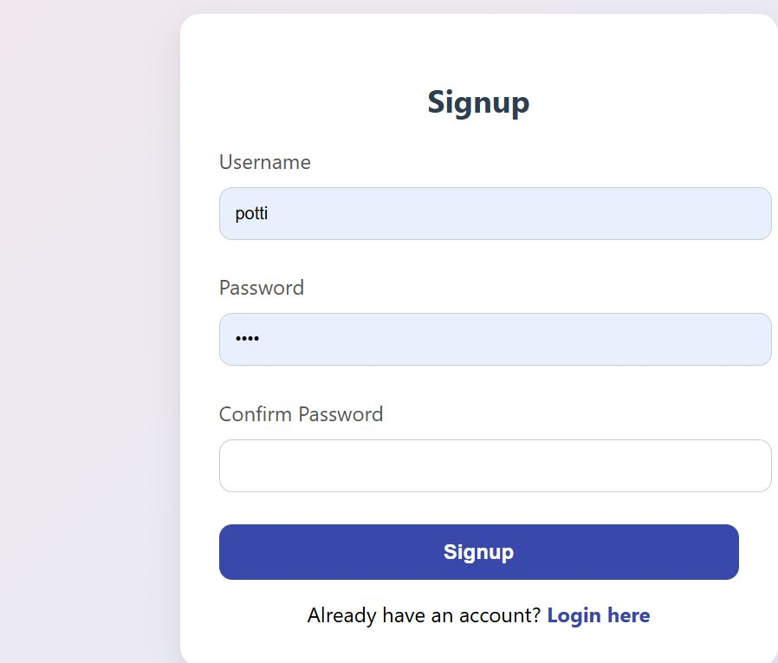
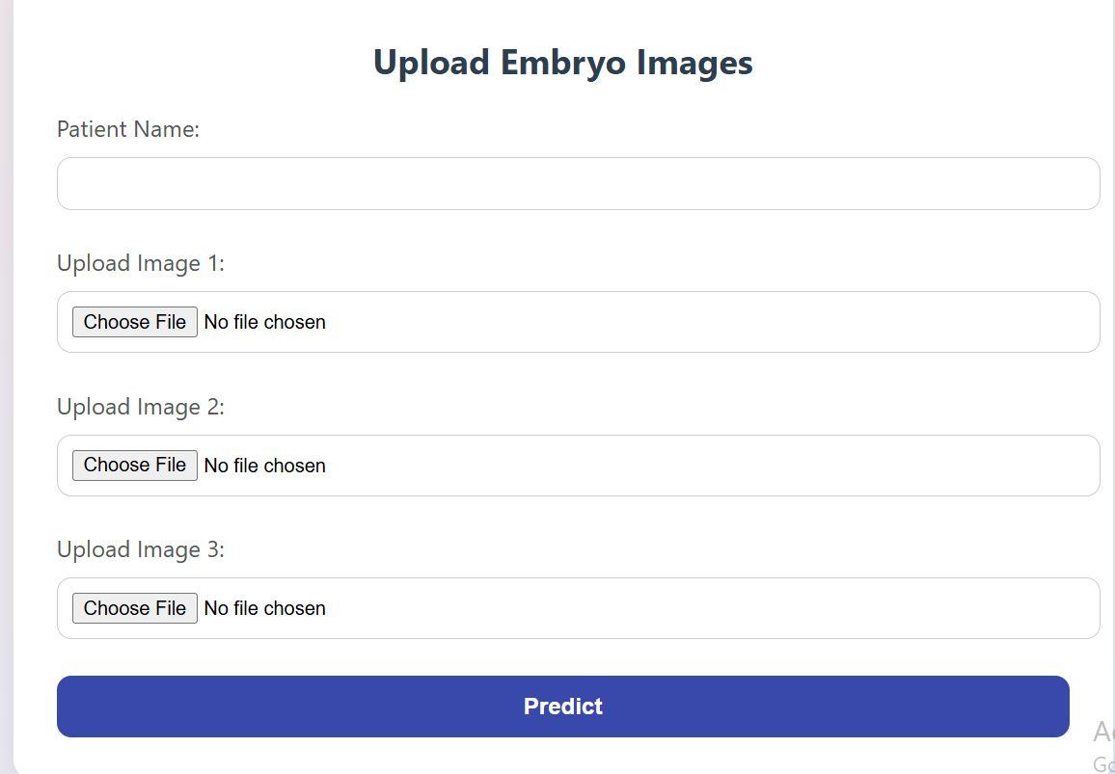
Model Deployment

Slide 26
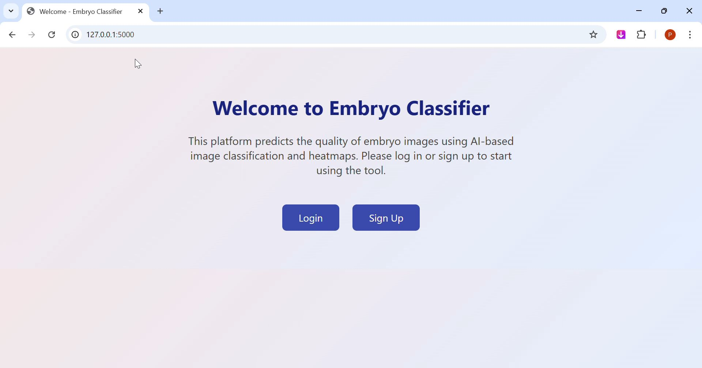
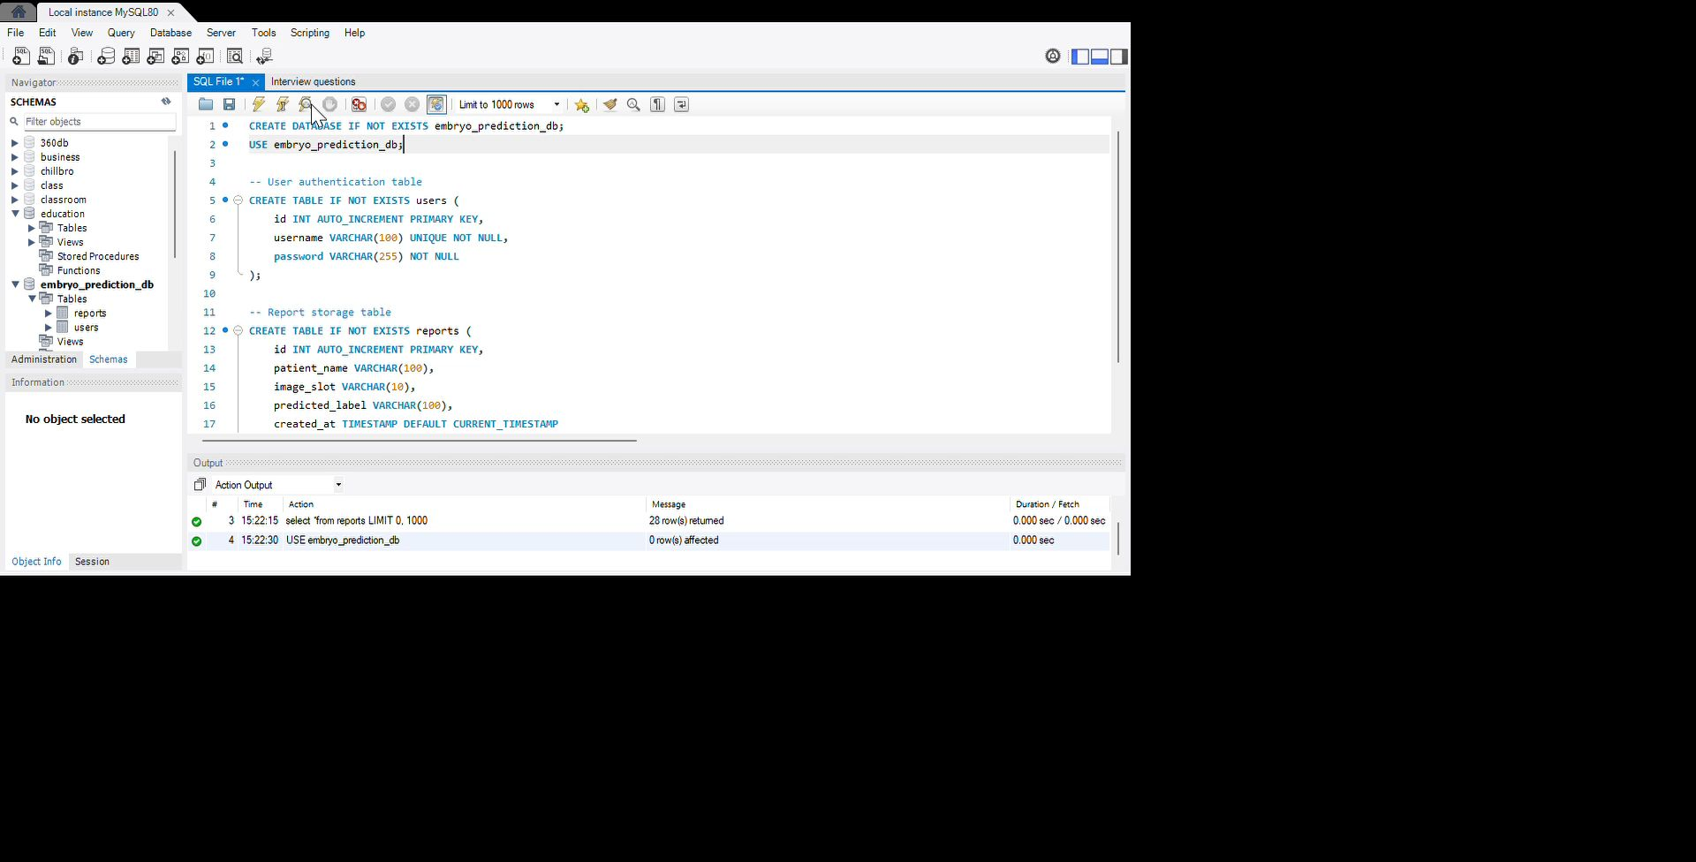
EMBRYO QUALITY PREDICTION
Video of Output

Slide 27












Results of the Embryo Quality Prediction System
Key findings and outcomes
Increased Success Rate
Cost Efficiency
Enhanced Decision-Making
User Engagement
Data-Driven Insights
The implementation of the Embryo Quality Prediction System has led to a significant increase in the success rate of ART procedures, achieving a 15% improvement over previous benchmarks.
By optimizing embryo selection, the system has reduced treatment costs by 30%, allowing for more affordable ART options for patients.
The interactive dashboard has increased user engagement, with clinicians actively utilizing the system for real-time assessments.
The system has generated valuable data insights, contributing to ongoing research and development in embryo quality assessment.
Clinicians reported improved confidence in their decision-making processes due to the predictive insights provided by the system.

Slide 28
Integration Strategies
Key approaches for integrating the Embryo Quality Prediction System with existing workflows.
API Integration
Utilize RESTful APIs to facilitate seamless communication between the Embryo Quality Prediction System and existing clinical systems.
Data Interoperability
Ensure compatibility with various data formats and standards to enhance data sharing and usability.
User Training
Provide comprehensive training for users to effectively utilize the system within their workflows.
Feedback Mechanisms
Implement feedback loops to gather user insights and continuously improve system integration.
Compliance and Security
Adhere to regulatory standards and ensure data security during integration processes.

Slide 29






Embryo Quality Prediction Insights
Challenges
Future Scope
Data Challenges: Limited data availability, class imbalance, standardization issues, quality variation; Technical Challenges: Model generalization, confidence calibration, resource constraints, real-time processing; Clinical Integration Challenges: Workflow integration, interpretability requirements, trust building, domain knowledge transfer; Deployment Challenges: Security requirements, scalability, user experience, regulatory considerations; Evaluation Challenges: Ground truth variability, performance metrics, validation methodology, edge cases
Enhanced Model Capabilities: Time-series prediction, multi-modal integration, self-supervised learning, uncertainty quantification, active learning; Advanced Features: Automated reporting, predictive analytics, embryo ranking, anomaly detection, developmental stage prediction; Platform Expansion: Mobile application, API ecosystem, cloud-based service, multi-language support, offline capability; Integration Opportunities: EHR/EMR integration, IVF laboratory systems, telemedicine platforms, research databases, quality control systems; Research Directions: Outcome correlation, longitudinal studies, multi-center validation, comparative assessment, standardization initiative

Slide 30


Embryo Quality Prediction System

